Slide 1
Topic 6: Arrays
Part-1

Slide 2
Objectives
To describe why an array is necessary in programming.
To learn the steps involved in using arrays: declaring array reference variables and creating arrays.
To initialize the values in an array.
To store and process objects in an array.
To develop and invoke methods with array arguments and return type.

Slide 3
Why Use Arrays?
Compute Average Daily Temperature Using Variables
var temp1 = 28.5;
var temp2 = 30.6;
var temp3 = 29.2;
var temp4 = 30.8;
var temp5 = 31.2;
var temp6 = 30.2;
var temp7 = 29.5;
var avgTemp;
avgTemp = (temp1 + temp2 + temp3 + temp4 +
temp5 + temp6 + temp 7) / 7;
console.log("Avg temp for the week: " +
avgTemp)
What if you have to find the average temp for 365 days?
Is there a more efficient way?
Yes. We can use an array to improve the management and processing of data items.

Slide 4
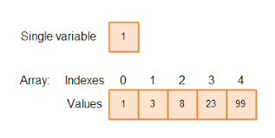
Different visual representation of Arrays:

Slide 5
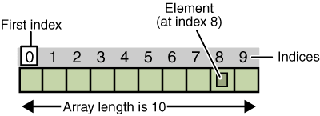
Different visual representation of Arrays:

Slide 6
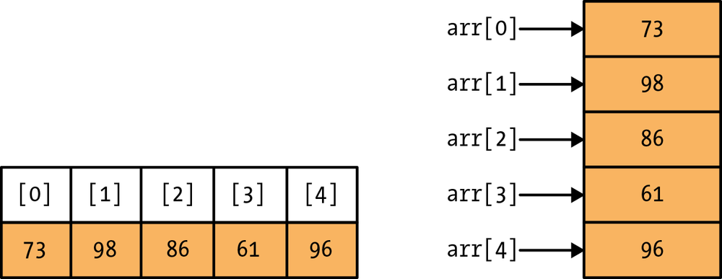
Different representation → horizontal or vertical (same)
It doesn’t matter….
What’s the array size?
What does the 3rd element contain?

Slide 7
Can you think of daily living, office setting, schools, etc……where your can use arrays to store data?
Type on the Meeting chat, give me an example.

Slide 8
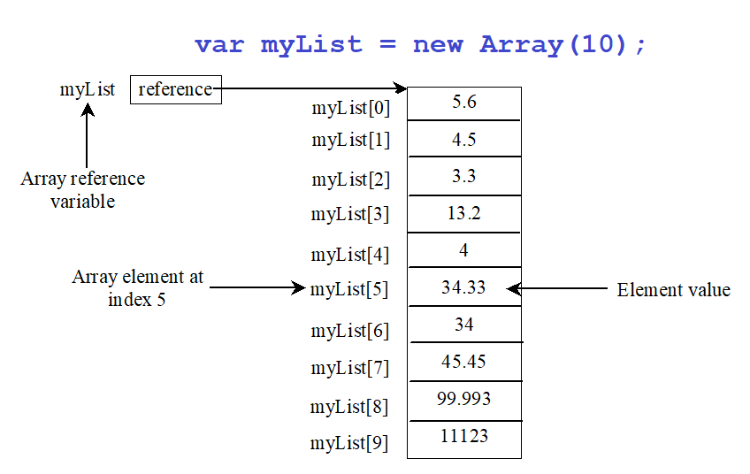
Introducing Arrays
An array is a data structure that represents a collection of the same or different type of data.

Slide 9
Creating an Array
var arrayRefVar = new Array(size);
Example:
var[] myList = new Array(10);
The above statement does two things:
Creates an array object with 10 elements.
Assigns the reference of the newly created array to the variable arrayRefVar.

Slide 10
Creating an Array
var myList = new Array(10);
myLis
t
reference
0.0
0.0
0.0
0.0
0.0
0.0
0.0
0.0
0.0
0.0
The array elements are accessed through the index. The array indices are 0-based, i.e., it starts from 0 to myList.length-1.
myList[0]
myList[1]
Array reference
myList[2]
variable
myList[3]
myList[4]
Array element at
myList[5]
Element value
index 5
myList[6]
myList[7]
myList[8]
myList[9]
myList
myList[0] references the first element in the array.
myList[9] references the last element in the array.

Slide 11
Example
Declare an array to store the temperature of 7 days:
var temp = new Array(7);
The length of the array is determined by the number of elements in the array
Length is a property of an array object.
E.g. console.log(temp.length); //prints 7
The index number always starts with 0
Last element index is 1 less than array size
0 1 2 3 4 5 6
index
temp
temp[0]
temp[6]

Slide 12
Creating an Array
    An array can be created empty, with a length or with elements.
//Empty array without a length
var a1 = new Array();
//Empty array with a length
var a2 = new Array(5);
//Another way to create an empty array without a length
var a3 = [];
//Array with elements
var a4 = ["Cat", "Dog", "Hamster", "Chinchilla"];
//Another way to create an array with elements
var a4 = new Array("Cat", "Dog", "Hamster", "Chinchilla");

Slide 13
Array Element Data Type
An element inside an array can be of any type, and different elements of the same array can be of different types: string, boolean, even objects or other arrays.
This means it is possible to create an array that has a string in the first position, a number in the second and a Boolean in the third as follows:
var myArray = ["Hello World", 88.88, false];
var omg = ["wow!", myArray];

Slide 14
Accessing Array Element
Array elements are accessed through the index.
The array index starts from 0 to arrayRefVar.length - 1.
E.g. myList holds 10 elements and the indices are from 0 to 9.
Each element in the array is represented using the following syntax, known as an indexed variable:
  arrayRefVar[index];
  E.g. x = [44,55,88,99];
  console.log(x[2]); //prints 88

Slide 15
Accessing Array Element
After an array is created, an indexed variable can be used in the same way as a regular variable.
For example, the following code adds the value in myList[0] and myList[1] to myList[2].
  myList[2] = myList[0] + myList[1];

Slide 16

Let’s Try It!
Which of the following statement(s) can be used to create a new array?
var animalList = Array (4);
var animalList = new array();
var animalList = [“Leopard”, 12, “Puma”, 15];
var animalList = new (“Lion”, “Tiger”);
var animalList = new array(2);
Notes:
Answer: Option C

Slide 17
Let’s Try It!
Which of the following code retrieve the size for array animalList?
animalList.length ( )
animalList.size ( )
animalList.length
animalList.len
Notes:
Answer: Option C

Slide 18
Let’s Try It!
Given the following array, which statement will print out “Lion”?
var animalList = [“Tiger”, “Leopard”, “Puma”, “Lion”];
console.log (animalList [ 4 ] );
console.log (animalList [animalList.length – 1 ] );
console.log (animalList [animalList.length ] );
console.log (animalList [animalList.length – 2 ] );
Notes:
Answer: Option B

Slide 19
Default Values
When an array is created with a length, its elements are assigned the default value of undefined.
In JavaScript, the undefined value indicates that a variable has not been initialized (has not been assigned a value).
For example:
var a1 = new Array(3);
var x;
console.log(a1[0]); //prints undefined
console.log(a1[1]); //prints undefined
console.log(a1[2]); //prints undefined
console.log(x); //also prints undefined

Slide 20
Let’s Try It!
What will the following code return?
var numArr = [ "1", 2, 9, "4", 16 ];
console.log( numArr["4"] );
"4"
16
undefined
None of the above.
Notes:
Answer: Option B

Slide 21
Let’s Try It!
What will the following code return?
var numArr = [ "1", 2, 9, "4", 16 ];
console.log( numArr[1] + (numArr[2] + numArr[3]) );
15
129
213
294
Notes:
Answer: Option D

Slide 22
Let’s Try It!
What is the output for the following codes?
var myArr = new Array(4);
console.log(myArr[0], “myArr[2]”);
3, 3
myArr[0], myArr[2]
undefined, myArr[2]
undefined, undefined
Notes:
Answer: Option C

Slide 23
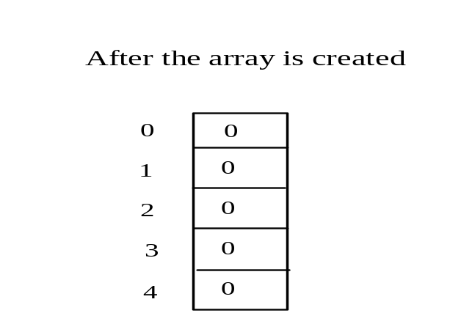
Array Example
var values = [0,0,0,0,0];
for (var i = 1; i < 5; i++) {
values[i] = i + values[i-1];
}
values[0] = values[1] + values[4];
Declare array variable values, create an array, and assign its reference to values

Slide 24

Array Example
var values = [0,0,0,0,0];
for (var i = 1; i < 5; i++) {
values[i] = i + values[i-1];
}
values[0] = values[1] + values[4];
i = 1
i becomes 1

Slide 25
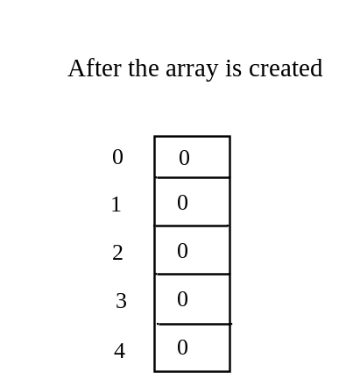
Array Example
var values = [0,0,0,0,0];
for (var i = 1; i < 5; i++) {
values[i] = i + values[i-1];
}
values[0] = values[1] + values[4];
i = 1
i (=1) is less than 5

Slide 26
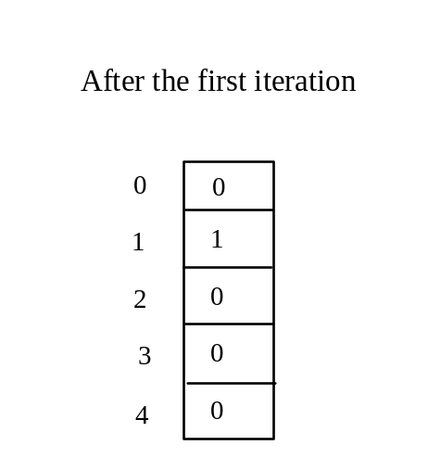
Array Example
var values = [0,0,0,0,0];
for (var i = 1; i < 5; i++) {
values[i] = i + values[i-1];
}
values[0] = values[1] + values[4];
i = 1
After this line is executed, value[1] is 1

Slide 27
Array Example
var values = [0,0,0,0,0];
for (var i = 1; i < 5; i++) {
values[i] = i + values[i-1];
}
values[0] = values[1] + values[4];
i = 2
After i++, i becomes 2

Slide 28
Array Example
var values = [0,0,0,0,0];
for (var i = 1; i < 5; i++) {
values[i] = i + values[i-1];
}
values[0] = values[1] + values[4];
i = 2
i (= 2) is less than 5

Slide 29
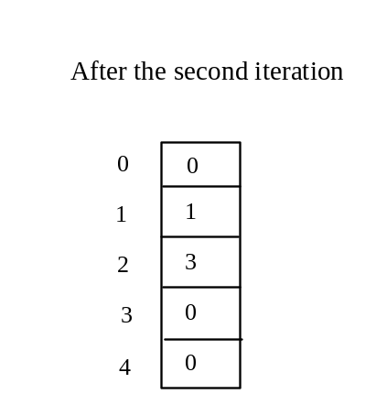
Array Example
var values = [0,0,0,0,0];
for (var i = 1; i < 5; i++) {
values[i] = i + values[i-1];
}
values[0] = values[1] + values[4];
i = 2
After this line is executed,
values[2] is 3 (2 + 1)

Slide 30
Array Example
var values = [0,0,0,0,0];
for (var i = 1; i < 5; i++) {
values[i] = i + values[i-1];
}
values[0] = values[1] + values[4];
i = 3
After this, i becomes 3.

Slide 31
Array Example
var values = [0,0,0,0,0];
for (var i = 1; i < 5; i++) {
values[i] = i + values[i-1];
}
values[0] = values[1] + values[4];
i = 3
i (=3) is still less than 5.

Slide 32
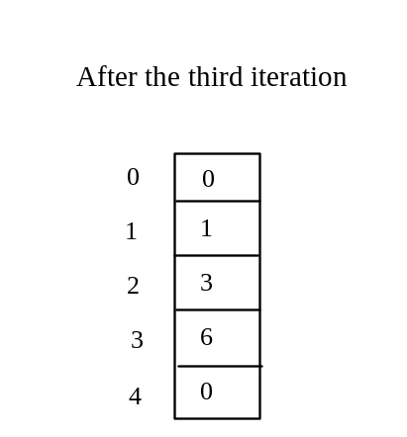
Array Example
var values = [0,0,0,0,0];
for (var i = 1; i < 5; i++) {
values[i] = i + values[i-1];
}
values[0] = values[1] + values[4];
i = 3
After this line, values[3] becomes 6 (3 + 3)

Slide 33

Array Example
var values = [0,0,0,0,0];
for (var i = 1; i < 5; i++) {
values[i] = i + values[i-1];
}
values[0] = values[1] + values[4];
i = 4
After this, i becomes 4

Slide 34
Array Example
var values = [0,0,0,0,0];
for (var i = 1; i < 5; i++) {
values[i] = i + values[i-1];
}
values[0] = values[1] + values[4];
i = 4
i (=4) is still less than 5

Slide 35
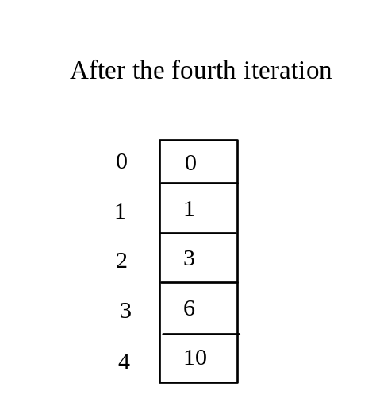
Array Example
var values = [0,0,0,0,0];
for (var i = 1; i < 5; i++) {
values[i] = i + values[i-1];
}
values[0] = values[1] + values[4];
i = 4
After this, values[4] becomes 10 (4 + 6)

Slide 36
Array Example
var values = [0,0,0,0,0];
for (var i = 1; i < 5; i++) {
values[i] = i + values[i-1];
}
values[0] = values[1] + values[4];
i = 5
After i++, i becomes 5

Slide 37
Array Example
var values = [0,0,0,0,0];
for (var i = 1; i < 5; i++) {
values[i] = i + values[i-1];
}
values[0] = values[1] + values[4];
i = 5
i ( =5) < 5 is false. Exit the loop

Slide 38
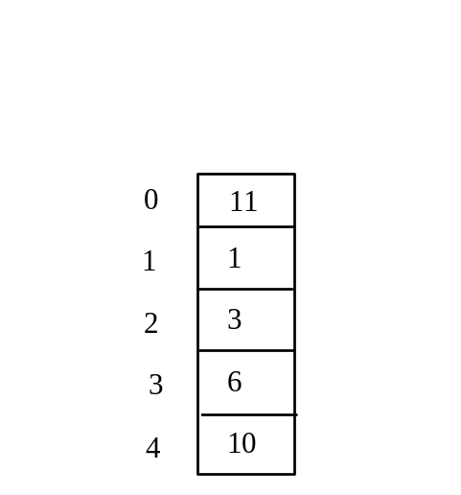
Array Example
var values = [0,0,0,0,0];
for (var i = 1; i < 5; i++) {
values[i] = i + values[i-1];
}
values[0] = values[1] + values[4];
After this line, values[0] is 11 (1 + 10)

Slide 39
Dynamic Array
In fact, arrays in JavaScript are all dynamic in size. This means you can create an empty array without specifying its length. Whenever you assign a new value to the array, its size then will grow dynamically.
var list1 = new Array(); //array without length
for (var i=0; i < 8; i++ ) {
list1[i] = "Hello" + i; //or. . .
//list1.push("Hello" + i); //push = add last
}
Hello1 | Hello2 | Hello3 | Hello4 | Hello5 | Hello6 | Hello7
0 | 1 | 2 | 3 | 4 | 5 | 6

Slide 40
Let’s see how the .push works !
var animal = new Array("Cat", "Dog", "Hamster", “Rat");
console.log("Length of animal array BEFORE push : " + animal.length);
console.log("Element animal[0] : " + animal[0]);
console.log("Element animal[1] : " + animal[1]);
console.log("Element animal[2] : " + animal[2]);
console.log("Element animal[3] : " + animal[3]);
animal.push("Rabbit");
console.log(“\nLength of animal array AFTER push : " + animal.length);
console.log("Element animal[0] : " + animal[0]);
console.log("Element animal[1] : " + animal[1]);
console.log("Element animal[2] : " + animal[2]);
console.log("Element animal[3] : " + animal[3]);
console.log("Element animal[4] : " + animal[4]);
console.log();
console.log(animal);

Slide 41
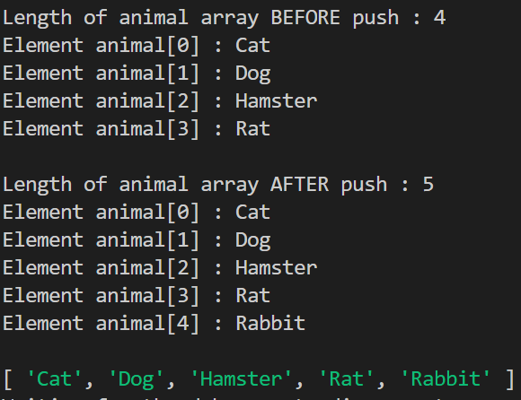
Results of the .push !

Slide 42
Exercise : for loop
var animal = new Array("Cat", "Dog", "Hamster", “Rat");
console.log("Length of animal array BEFORE push : " + animal.length);
console.log("Element animal[0] : " + animal[0]);
console.log("Element animal[1] : " + animal[1]);
console.log("Element animal[2] : " + animal[2]);
console.log("Element animal[3] : " + animal[3]);
animal.push("Rabbit");
console.log(“\nLength of animal array AFTER push : " + animal.length);
console.log("Element animal[0] : " + animal[0]);
console.log("Element animal[1] : " + animal[1]);
console.log("Element animal[2] : " + animal[2]);
console.log("Element animal[3] : " + animal[3]);
console.log("Element animal[4] : " + animal[4]);
console.log();
console.log(animal);
Write a for loop to print the elements

Slide 43
Let’s Try It!
What is the output of the following statements?
var animalList = [“Leopard”, “Puma”, “Lion”];
animalList.push( “Cheetah”);
console.log( animalList );
[“Cheetah”, “Leopard”, “Puma”, “Lion”];
[“Lion”, “Leopard”, “Puma”, “Cheetah”,];
[“Leopard”, “Puma”, “Lion”, “Cheetah”];
[“Puma”, “Leopard”, “Lion”, “Cheetah”];
Notes:
Answer: Option C

Slide 44
Let’s Try It!
What is the output of the following statements?
var animalList = [“Tiger”, “Puma”, “Lion”];
animalList.pop( );
console.log( animalList );
[“Lion”, “Puma”, “Tiger”];
[“Tiger”, “Lion”];
[“Puma”, “Lion”];
[“Tiger”, “Puma”];
Notes:
Answer: Option D

Slide 45
Processing Arrays
When processing array elements, we often use a for loop.
The following loop initializes the array myList with random values between 1 and 100.
var myList = new Array();
for (var i=1; i <= 5; i++ ) {
myList.push(Math.floor(Math.random() * 100) + 1);
}

Slide 46


Processing Arrays – Printing arrays
To display array content, you can use for-loop as follows:
for (var i=0; i < myList.length; i++ ) {
console.log( myList[i]);
}
Or simply execute…
console.log(myList);

Slide 47
Processing Arrays – Computing sum
To sum all element in an array, use a variable named total to store the sum. Initially total is 0. Add each element in the array to total, using for loop.
var total =0;
for (var i=0; i < myList.length; i++ ) {
total += myList[i];
}
var avg = total / myList.length;
To calculate the average of the array, use a variable named avg.

Slide 48

Let’s Try It!
What is the output of the following codes?
var numArr = new Array(10);
for(var i = 0 ; i < numArr.length; i+=2) {
numArr[i] = i + 1;
}
console.log(numArr[2], numArr[9]);
[2,9]
[2, undefined]
[3,9]
[3, undefined]
Notes:
Answer: Option D

Slide 49

Let’s Try It!
What is the output of the following codes?
var numArr = new Array(5, 1, 3, -5, 8, -4);
for (var k = 1; k < numArr.length; k += 2) {
numArr[k] +=numArr[k];
}
console.log(numArr);
[ 5, 2, 3, -10, 8, -8 ]
[ 10, 1, 6, -5, 16, -4 ]
[ 5, 4, 6, -10, 16, -8 ]
[ 10, 4, 6, -10, 16, -8 ]
Notes:
Answer: Option A

Slide 50
Processing Arrays – Finding the largest element
To find the largest element, use a variable named max to store the largest element. Initially max to myList[0].
Compare each element in myList with max, update max if the element is greater than max.
var max = myList[0];
for (var i=1; i < myList.length; i++ ) {
if ( myList[i] > max)
max = myList[i];
}

Slide 51
Processing Arrays - Finding the smallest index of the largest element
To find the index of the largest element of an array, add some code from the previous slide:
var max = myList[0];
var indexOfMax;
for (var i=1; i < myList.length; i++ ) {
if ( myList[i] > max){
max = myList[i];
indexOfMax = i;
}
}
Can you replace
with ?
if ( myList[i] > max )
if ( myList[i] >= max )

Slide 52
Example Testing Arrays
Objective: The program receives 6 numbers from the keyboard, finds the largest number and counts the occurrence of the largest number entered from the keyboard.
Suppose you entered 3, 5, 2, 5, 5, and 5, the largest number is 5 and its occurrence count is 4.

Slide 53
Example Testing Arrays
var input = require('readline-sync');
const TOTAL_NUMBERS = 6;
var numbers = new Array(TOTAL_NUMBERS);
//read all numbers
for(var i = 0 ; i < numbers.length ; i++) {
numbers[i] = input.question("Enter a number: ");
}

Slide 54
Example Testing Arrays
//find largest
var max = numbers[0];
for(var i = 1 ; i < numbers.length ; i++) {
if(max < numbers[i])
max = numbers[i];
}
//find the occurrence of the largest number
var count = 0;
for(var i = 0 ; i < numbers.length ; i++) {
if(numbers[i] == max)
count++;
}

Slide 55
End

